Slide 1

Music

Slide 2
Evolution of a Mindfulness Based Stress Relief Program for the Community College Campus
Megan Mamolen, PhD, MLIS
Ragan Snead, MLIS, MBA

Slide 3
Introduction to Mindfulness in Higher Education
Mindfulness has taken off as an option for alleviating stress and improving mood. Indeed, psychologists and meditation teachers have confirmed the efficacy of mindfulness practices in clinical settings (Kabat-Zinn, 2013). As educators recognize the value of mindfulness practices, activities like meditation and yoga are making their way onto our campuses, including academic library spaces and community college classrooms (Funaro, Rojiani and Norton, 2019; Martin, 2018). While meditation exercises are the focus of academic mindfulness curricula and are routinely shown to enhance behavior, learning outcomes, and community engagement, educators are finding additional mindfulness practices, such as the simple act of coloring, lead to student success as well (Leland, 2015; Stallman, Ohan, and Chiera, 2017; Flett et al., 2017). These active mindfulness options are sometimes more affordable and accessible to students who find meditation challenging (Burrows, 2016).
Lakeland Community College Library has considered a variety of mindfulness options, and while we teach meditation to interested participants, we have landed on a more comprehensive stress relief program of consistent and experimental activities. Our program is designed to assist our students in their academic studies, promote a supportive community, and showcase the wellness talents of our staff. In designing our program, we are committed to being mindful of the diverse needs of our students on campus.

Slide 4
Background
Description of library patrons/campus
Commuter community college campus
Predominantly non-traditional students in health
and college credit plus programs:
Challenging majors
Demanding jobs
Various family responsibilities
Indications of greater mental health needs on campus
Economic issues
Personal circumstances
Active shooter situation
Pandemic

Slide 5
Goals
To create a program of intentional mindfulness-based activities to help address student stress levels and mental health needs on campus.
Make the library a hub for collaboration and community support on campus.

Slide 6

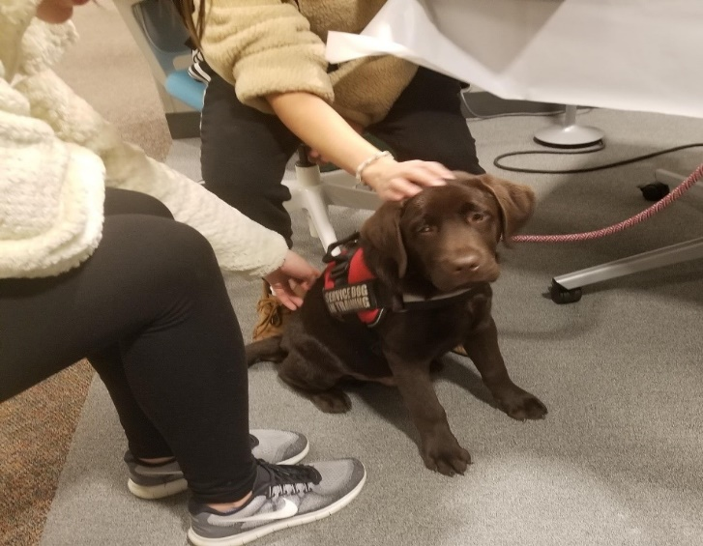
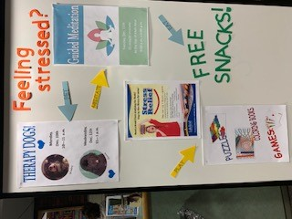
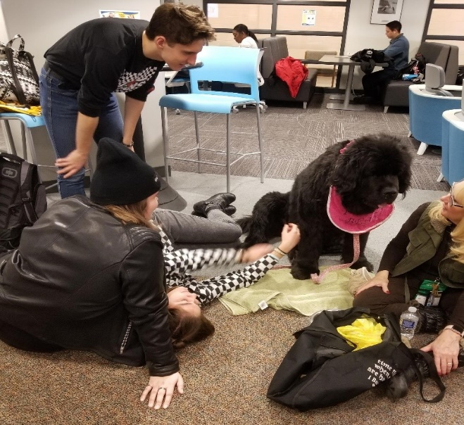
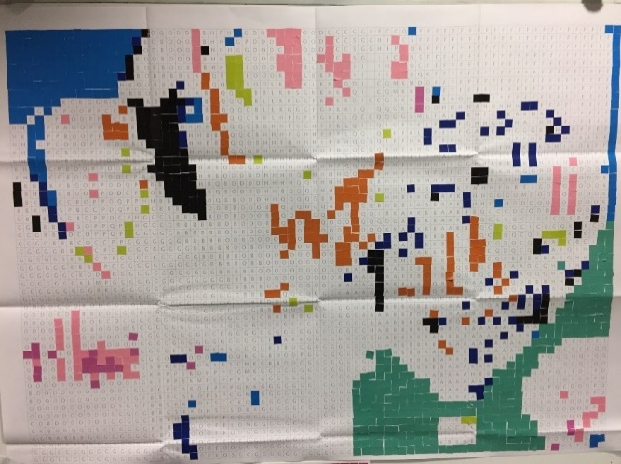
Methods – Consistent
Simple stress-relief activities offered consistently twice each semester to bring the campus together.
Focused therapy dog program
Community-owned dogs from local students & faculty
Meditation in the library
Provided by library staff
Meditation resource guide
Community connection activity
Community color
Sticker mosaic

Slide 7
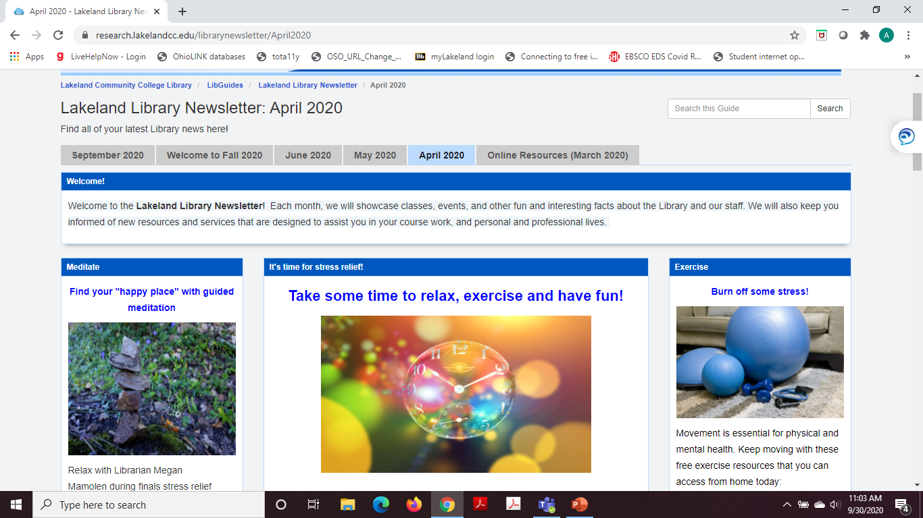
Methods - Experimental
Stress relief activities that change frequently to make offerings more accessible to a larger audience with diverse needs.
Passive
Relaxation room with music, aromatherapy, kinetic sand; Laptop stations with animal videos
Active
Guitars; hoola-hoops; putt-putt; hacky-sacks
Virtual
Pandemic stress relief newsletter
Guided meditation sessions online

Slide 8
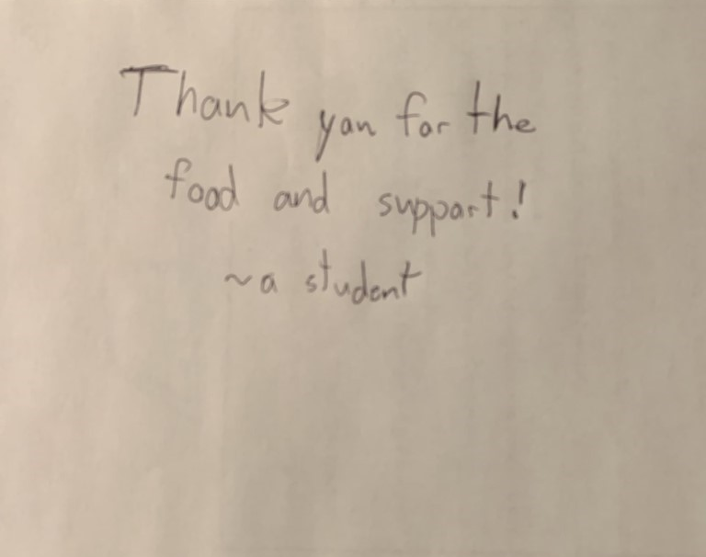
Takeaways - Feedback
Circumstances have shown these activities are needed year-round, and they are desired more frequently, but it is challenging to achieve consistent participation.
Qualitative feedback:
Conversations at service desks
Requests from Lakeland Student Government and campus faculty for their own consistent meditation groups
Requests from library student group to partner with Teaching and Learning Center for dog-child reading program

Slide 9
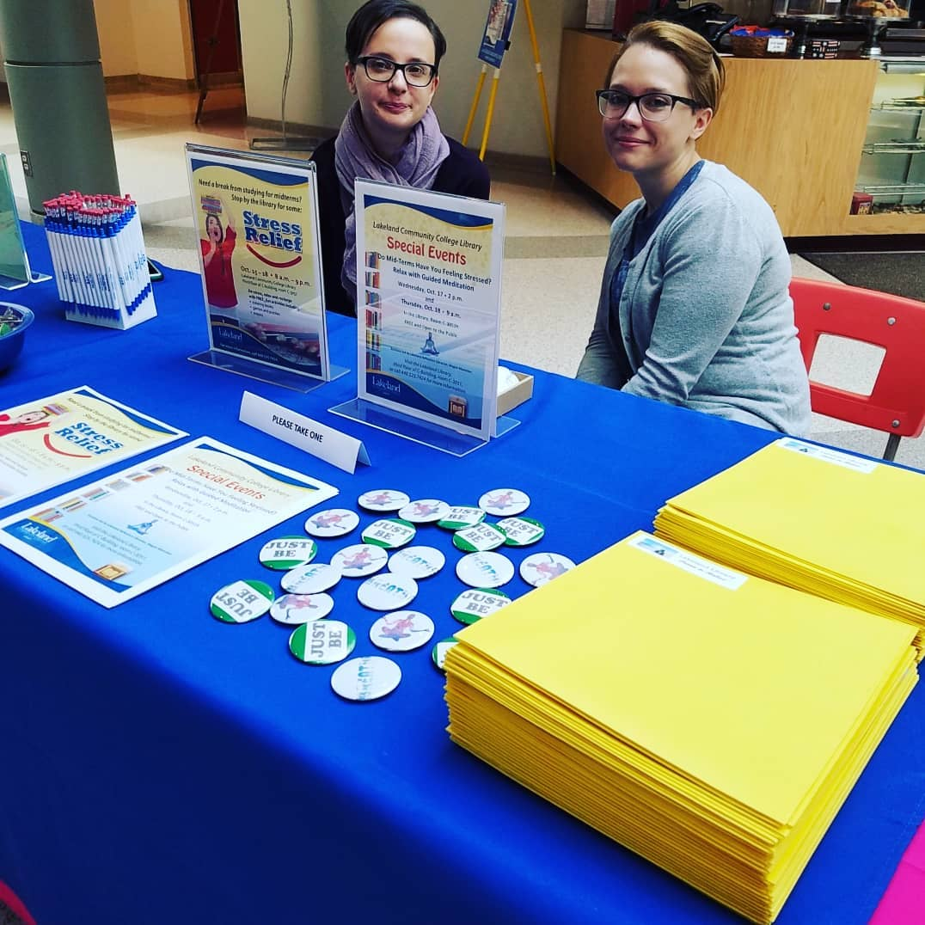
Takeaways - Opportunities
Provides library with opportunities to expand program outside of its doors, including online.
Librarian was keynote speaker at employee wellness week event
Circulation Coordinator joined college wellness committee
Librarian joined college Mental Health Task Force
Library staff and programs showcased during Balance Matters student wellness fair
Librarian teaching meditation to psychology classes each semester
Library stress relief newsletter sent to entire campus

Slide 10
Future Directions
Need for assessment (how are we affecting/influencing student behavior?)
Survey of user feedback
How did the activities influence your stress levels, and will you continue these self-care activities?
How are you using these activities outside of the library/campus?
Survey for mindfulness activities at other library events - opportunity to get repeat participants
Incorporation into online feedback form
More virtual and accessible options
More frequent offerings
Student-designed events
Additional marketing – newsletters, email listserv
Approach wellness committees and mental health task force about including mindfulness activities in curriculum

Slide 11
References
Burrows, L. (2016). Safeguarding mindfulness meditation for vulnerable college students. Mindfulness, 7(1), 284–285. https://doi-org.ezproxy.lakelandcc.edu/10.1007/s12671-015-0434-3
De Boer, M. (2017). Tender Steps [audio file]. Retrieved from http://dig.ccmixter.org/files/NiGiD/56286 .
Flett, J. A. M., Lie, C., Riordan, B. C., Thompson, L. M., Conner, T. S., & Hayne, H. (2017). Sharpen your pencils: Preliminary evidence that adult coloring reduces depressive symptoms and anxiety. Creativity Research Journal, 29(4), 409–416. https://doi-org.ezproxy.lakelandcc.edu/10.1080/10400419.2017.1376505
Funaro, M. C., Rojiani, R., & Norton, M. J. (2019). Improving community well-being through collaborative initiatives at a medical library. Journal of the Medical Library Association, 107(3), 425–431. https://doi-org.ezproxy.lakelandcc.edu/10.5195/jmla.2019.486
Kabat-Zinn, J. (2013). Full catastrophe living. New York: Bantam Books.
Leland, M. (2015). Mindfulness and Student Success. Journal of Adult Education, 44(1), 19–24.
Martin, M. (2018). Mindfulness and transformation in a college classroom. Adult Learning, 29(1), 5–10. https://doi-org.ezproxy.lakelandcc.edu/10.1177/1045159517744752
Stallman, H. M., Ohan, J. L., & Chiera, B. (2018). The role of social support, being present, and self‐kindness in university student psychological distress. Australian Psychologist, 53(1), 52–59. https://doi-org.ezproxy.lakelandcc.edu/10.1111/ap.12271

Slide 12
End
Music: Tender Steps by Martijn de Boer (NiGiD). Copyright 2017 Licensed under a Creative Commons Attribution Noncommercial (3.0) license. http://dig.ccmixter.org/files/NiGiD/56286 Ft: Javolenus

